Slide 1

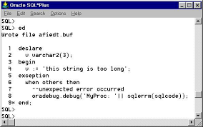
Introduction to PL/SQL

Slide 2
What is PL/SQL
Procedural Language – SQL
Allows using general programming tools with SQL, for example: loops, conditions, functions, etc.
We write PL/SQL code in a regular file, for example PL.sql, and load it with @PL in the sqlplus console.

Slide 3
Why PL/SQL
Acts as host language for stored procedures and triggers.
Provides the ability to add middle tier business logic to client/server applications.
Provides Portability of code from one environment to another
Improves performance of multi-query transactions.
Provides error handling

Slide 4
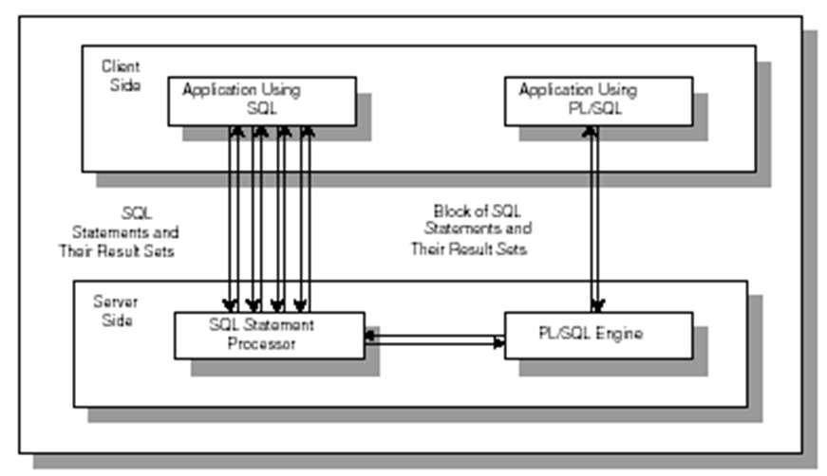
Comparison of SQL*PLUS and PL/SQL

Slide 5
PL/SQL Blocks
PL/SQL code is built of Blocks, with a unique structure.
There are two types of blocks in PL/SQL:
1. Anonymous Blocks: have no name (like scripts)
can be written and executed immediately in SQLPLUS
2. Named Blocks:
Procedures
Functions

Slide 6
Anonymous Block Structure:
DECLARE (optional)
/* Here you declare the variables you will use in this block */
BEGIN (mandatory)
/* Here you define the executable statements (what the block DOES!)*/
EXCEPTION (optional)
/* Here you define the actions that take place if an exception is thrown during the run of this block */
END; (mandatory)
/
A correct completion of a block will generate the following message:
PL/SQL procedure successfully completed
Always put a new line with only a / at the end of a block! (This tells Oracle to run the block)

Slide 7
The 'Hello World' Example:
DECLARE
message varchar2(20):= 'Hello, World!';
BEGIN
dbms_output.put_line(message);
END;
/
Output:
Hello World PL/SQL
procedure successfully completed.

Slide 8
DECLARATION SECTION
The declaration section is the first section of the PL/SQL block.
It contains definitions of PL/SQL identifiers such as variables, constants, cursors and so on.
Example
DECLARE
v_first_name VARCHAR2(35) ;
v_last_name VARCHAR2(35) ;
v_counter NUMBER := 0 ;

Slide 9
EXECUTABLE SECTION
The executable section is the next section of the PL/SQL block.
This section contains executable statements that allow you to manipulate the variables that have been declared in the declaration section.
BEGIN
SELECT first_name, last_name
INTO v_first_name, v_last_name
FROM student
WHERE student_id = 123 ;
DBMS_OUTPUT.PUT_LINE
(‘Student name :’ || v_first_name ||‘ ’|| v_last_name);
END;

Slide 10
EXCEPTION-HANDLING SECTION
The exception-handling section is the last section of the PL/SQL block.
This section contains statements that are executed when a runtime error occurs within a block.
Runtime errors occur while the program is running and cannot be detected by the PL/SQL compiler.
EXCEPTION
WHEN NO_DATA_FOUND THEN
DBMS_OUTPUT.PUT_LINE
(‘ There is no student with student id 123 ’);
END;

Slide 11
PL/SQL IN SQL*PLUS
SQL*Plus is an interactive tool that allows you to type SQL or PL/SQL statements at the command prompt.
These statements are then sent to the database. Once they are processed, the results are sent back from the database and displayed on the screen.
There are some differences between entering SQL and PL/SQL statements.

Slide 12
SQL EXAMPLE
SELECT first_name, last_name
FROM student;
The semicolon terminates this SELECT statement. Therefore, as soon as you type semicolon and hit the ENTER key, the result set is displayed to you.

Slide 13
PL/SQL EXAMPLE
DECLARE
v_first_name VARCHAR2(35);
v_last_name VARCHAR2(35);
BEGIN
SELECT first_name, last_name
INTO v_first_name, v_last_name
FROM student
WHERE student_id = 123;
DBMS_OUTPUT.PUT_LINE
('Student name: '||v_first_name||' '||v_last_name);
EXCEPTION
WHEN NO_DATA_FOUND THEN
DBMS_OUTPUT.PUT_LINE
('There is no student with student id 123');
END;
.
/

Slide 14
GENERATING OUTPUT
Like other programming languages, PL/SQL provides a procedure (i.e. PUT_LINE) to allow the user to display the output on the screen. For a user to able to view a result on the screen, two steps are required.
First, before executing any PL/SQL program, type the following command at the SQL prompt
SQL> SET SERVEROUTPUT ON;
or put the command at the beginning of the program, right before the declaration section.

Slide 15
GENERATING OUTPUT
Second, use DBMS_OUTPUT.PUT_LINE in your executable section to display any message you want to the screen.
Syntax for displaying a message:
DBMS_OUTPUT.PUT_LINE(<string>);
in which PUT_LINE is the procedure to generate the output on the screen, and DBMS_OUTPUT is the package to which the PUT_LINE belongs.
DBMS_OUTPUT.PUT_LINE(‘My age is ‘ || num_age);

Slide 16
Guided Activity-1
Q1: Print your name using PL SQL block.
Q2: Write a simple PL/SQL script that displays
Hello
Hello Hello
Hello Hello Hello
Hello Hello Hello Hello
Hello Hello Hello Hello Hello
Hello Hello Hello Hello Hello Hello
Hello Hello Hello Hello Hello
Hello Hello Hello Hello
Hello Hello Hello
Hello Hello
Hello
Estimated Time: 15 Minutes.

Slide 17
Data Types
Scalar type | Numeric: INT, DEC,NUMBER,BINARY_INTEGER… Character: CHAR, CHARACTER, STRING, VARCHAR, VARCHAR2… Boolean: TRUE, FALSE. Date: DATE
Composite types | RECORD, TABLE, VARRAY
Reference types | CURSORS, OBJECT TYPES
Lob types | BFILE, LOB, CLOB, NLOB
Notes:
A chart of types in PL/SQL.

Slide 18
PL/SQL Scalar Data Types and Subtypes
PL/SQL Scalar Data Types and Subtypes come under the following
categories:
Date Type | Description
Numeric | Numeric values on which arithmetic operations are performed
Character | Alphanumeric values that represent single characters or strings of characters.
Boolean | Logical values on which logical operations are performed.
Datetime | Dates and times.
PL/SQL provides subtypes of data types. For example, the data type NUMBER has a subtype called INTEGER.

Slide 19
Common PL/SQL Data Types
CHAR ( max_length )
VARCHAR2 ( max_length )
NUMBER ( precision, scale )
BINARY_INTEGER – more efficient than number
RAW ( max_length )
DATE
BOOLEAN (true, false, null)
Also LONG, LONG RAW and LOB types but the capacity is usually less in PL/SQL than SQL

Slide 20
Declare Section
Syntax
Examples
identifier [CONSTANT] datatype [NOT NULL]
[:= | DEFAULT expr];
Notice that PL/SQL includes all SQL types, and more…
Declare
birthday DATE;
age NUMBER(2) NOT NULL := 27;
name VARCHAR2(13) := 'Levi';
magic CONSTANT NUMBER := 77;
valid BOOLEAN NOT NULL := TRUE;

Slide 21
Variable Scope in PL/SQL
There are two types of variable scope:
Local variables - variables declared in an inner block and not accessible to outer blocks.
Global variables - variables declared in the outermost block or a package.

Slide 22
Example
DECLARE
a integer := 10;
b integer := 20;
c integer; f real;
BEGIN
c := a + b;
dbms_output.put_line('Value of c: ' || c);
f := 70.0/3.0;
dbms_output.put_line('Value of f: ' || f);
END;
/
Output:
Value of c: 30
Value of f: 23.333333333333333333

Slide 23
Variable Scope - Example
DECLARE -- Global variables
num1 number := 95;
num2 number := 85;
BEGIN
dbms_output.put_line('Outer Variable num1: ' || num1);
dbms_output.put_line('Outer Variable num2: ' || num2);
DECLARE -- Local variables
num1 number := 195;
num2 number := 185;
BEGIN dbms_output.put_line('Inner Variable num1: ' || num1);
dbms_output.put_line('Inner Variable num2: ' || num2);
END;
END; /
Output:
Outer Variable num1: 95
Outer Variable num2: 85
Inner Variable num1: 195
Inner Variable num2: 185

Slide 24
Variable Naming Conventions
Two variables can have the same name if they are in different blocks (bad idea)
The variable name should not be the same as any table column names used in the block.

Slide 25
PL/SQL is strongly typed
All variables must be declared before their use.
The assignment statement
: =
is not the same as the equality operator
=
All statements end with a ;

Slide 26
Guided Activity-2
Q1: Write a PL/SQL code block to find sum and average of three numbers.
Q2: Write a PL/SQL code block to find Simple Interest.
Estimated Time: 20 Minutes.

Slide 27
Declaring Variables with the %TYPE Attribute
Accessing column ename in table employee
Examples
DECLARE
ename employee.ename%TYPE;
job VARCHAR2(30);
address employee.address%TYPE;
...
Accessing another variable

Slide 28
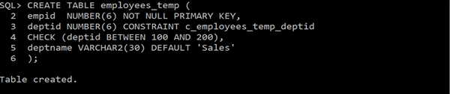
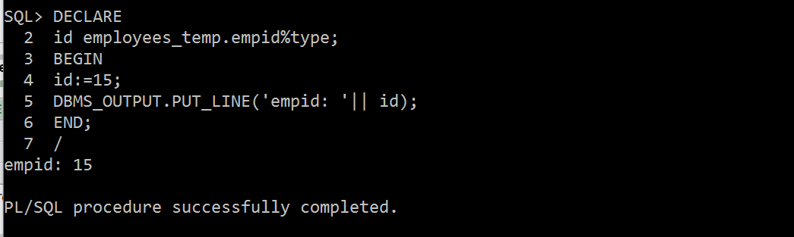
Example

Slide 29
Assigning SQL Query Results to PL/SQL Variables
You can use the SELECT INTO statement of SQL to assign values to PL/SQL variables. For each item in the SELECT list, there must be a corresponding, type-compatible variable in the INTO list.
CREATE TABLE CUSTOMERS(
ID INT NOT NULL,
NAME VARCHAR (20) NOT NULL,
AGE INT NOT NULL,
ADDRESS CHAR (25),
SALARY DECIMAL (18, 2),
PRIMARY KEY (ID) );
Table Created

Slide 30
Next, let us insert some values in the table:
INSERT INTO CUSTOMERS (ID,NAME,AGE,ADDRESS,SALARY)
VALUES (1, 'Ramesh', 32, 'Ahmedabad', 2000.00 );
INSERT INTO CUSTOMERS (ID,NAME,AGE,ADDRESS,SALARY)
VALUES (2, 'Khilan', 25, 'Delhi', 1500.00 );
INSERT INTO CUSTOMERS (ID,NAME,AGE,ADDRESS,SALARY)
VALUES (3, 'kaushik', 23, 'Kota', 2000.00 );
INSERT INTO CUSTOMERS (ID,NAME,AGE,ADDRESS,SALARY)
VALUES (4, 'Chaitali', 25, 'Mumbai', 6500.00 );
INSERT INTO CUSTOMERS (ID,NAME,AGE,ADDRESS,SALARY)
VALUES (5, 'Hardik', 27, 'Bhopal', 8500.00 );
INSERT INTO CUSTOMERS (ID,NAME,AGE,ADDRESS,SALARY)
VALUES (6, 'Komal', 22, 'MP', 4500.00 );

Slide 31
The following program assigns values from the above table to PL/SQL variables using the SELECT INTO clause of SQL:
DECLARE
c_id customers.id%type := 1;
c_name customers.name%type;
c_addr customers.address%type;
c_sal customers.salary%type;
BEGIN
SELECT name, address, salary INTO c_name, c_addr, c_sal
FROM customers WHERE id = c_id;
dbms_output.put_line ('Customer ' ||c_name || ' from ' || c_addr ||
' earns ' || c_sal);
END;
Output:
Customer Ramesh from Ahmedabad earns 2000

Slide 32
Guided Activity-3
Q1: Write a Pl/Sql program to display information of employees whose employee id is given.
Estimated Time: 15 Minutes.

